Slide 1
Ramsey Theory
Michael Amanti

Slide 2
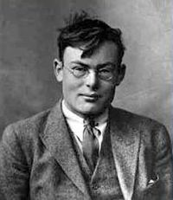
Ramsey Theory was developed by British mathematician, Frank Plumpton Ramsey.
Ramsey was born in 1903 to Stanley Ramsey and Mary Agnres Stanley, his father also was a mathematician.
He suffered from a mild depression most of his live and as a result was very interested in psychoanalysis even travelling to Vienna in order to be analyzed by the famous Theodor Reik.
Ramsey would die in the year 1930 having only lived twenty six years on this Earth.

Slide 3
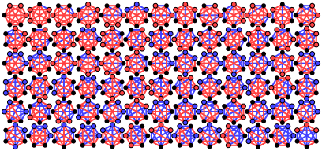
Ramsey Theory in essence states that in any coloring of the edges of a complete graph one can find monochromatic subgraphs.
The most famous example of Ramsey’s Theory is the two coloring example of K6 which is the complete graph of six vertices.
This says that when you have the complete graph of six vertices, no matter what coloring of the edges you choose you will always have either a complete graph of three vertices in color one or color two.
Notes:
Go to the board and show how this can be done practically with people’s names, then show why K5 doesn’t work. (because we are trying to find the minimum size needed to foRCE this pattern to occur.)

Slide 4
Network Theory
Network Theory is a section of combinatorics, that focuses on the analysis of graphs.
In Network Theory the graphs studied and analyzed are graphs that show the relationships of people, be they friendships, kinships, coworkers, etc.
Network Theory is relied upon heavily by Ramsey Theory, as at their core both show that in terms of graphs there is very little chaos occurring. The larger your set becomes the more order you are able to find.

Slide 5
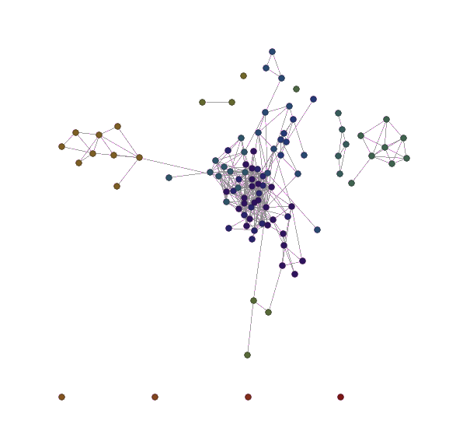
Notes:
The right hand side is family rightmost is dad’s side next to that is mom’s side
Outliers on the bottom are friends I made online, left hand side is dama and our other friends and her mom, middle is elementary and high school peeps etc etc etc
Talk about applications (family tree, friend networks, networking, most importantly criminal studies)

Slide 6
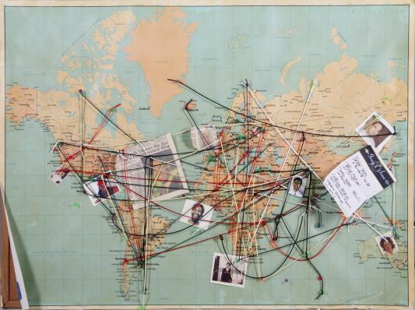
Notes:
We see things like this even today in popular culture, as seen here in heroes and it’s always sunny in Philadelphia

